Slide 1
MACHINE LEARNING A PROBABILISTIC VIEW
Himanshu Arora

Slide 2


DATA IS GENERATED FROM A REAL-WORLD PROCESS

Slide 3

A REAL-WORLD PROCESS CAN BE MODELED BY A PROBABILITY DISTRIBUTION

Slide 4


TRAINING GOAL: MATCHING THE MODEL DISTRIBUTION WITH THE DATA DISTRIBUTION
ML Algorithm

Slide 5
STEP 1: INITIALIZE THE MODEL WITH A RANDOM PROBABILITY DISTRIBUTION
RANDOM WEIGHTS
RANDOM DISTRIBUTION

Slide 6
STEP 2: MEASURE DISTANCE BETWEEN THE TWO DISTRIBUTIONS (LOSS)
KL DIVERGENCE

Slide 7
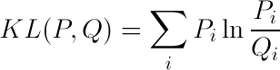
KULLBACK-LEIBLER DIVERGENCE

Slide 8
WE DO NOT WANT TO CHANGE THE DATA DISTRIBUTION: CROSS-ENTROPY
CROSS-ENTROPY

Slide 9
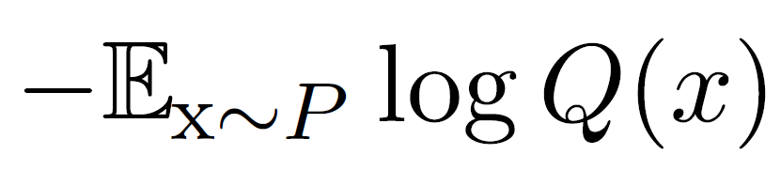
WE DO NOT WANT TO CHANGE THE DATA DISTRIBUTION: CROSS-ENTROPY

Slide 10
STEP 3: REDUCE THE DISTANCE BY UPDATING THE WEIGHTS OF THE MODEL
GRADIENT DESCENT

Slide 11
STEP 3: REDUCE THE DISTANCE BY UPDATING THE WEIGHTS OF THE MODEL
GRADIENT DESCENT

Slide 12
STEP 3: REDUCE THE DISTANCE BY UPDATING THE WEIGHTS OF THE MODEL
GRADIENT DESCENT

Slide 13

STEP 3: REDUCE THE DISTANCE BY UPDATING THE WEIGHTS OF THE MODEL

Slide 14
DIFFERENT APPROACHES

Slide 15
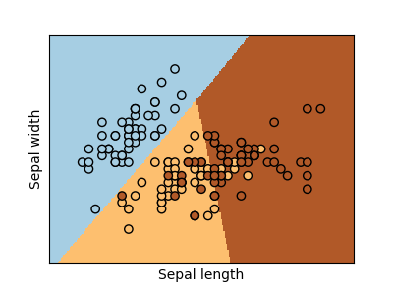
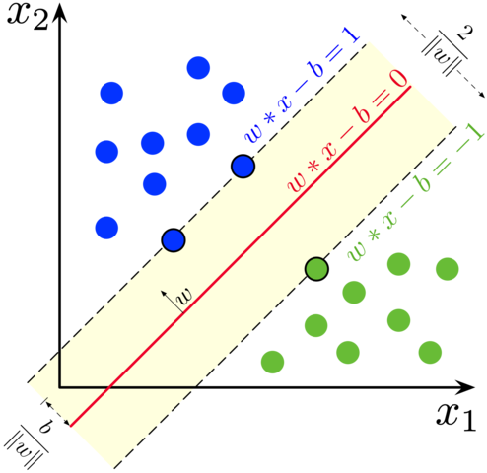
DISCRIMINATIVE
Learns the conditional probability of y given x
Logistic Regression Classifier
Support Vector Machine Classifier
Image sources:
https://scikit-learn.org/stable/auto_examples/linear_model/plot_iris_logistic.html
https://en.wikipedia.org/wiki/Support-vector_machine

Slide 16
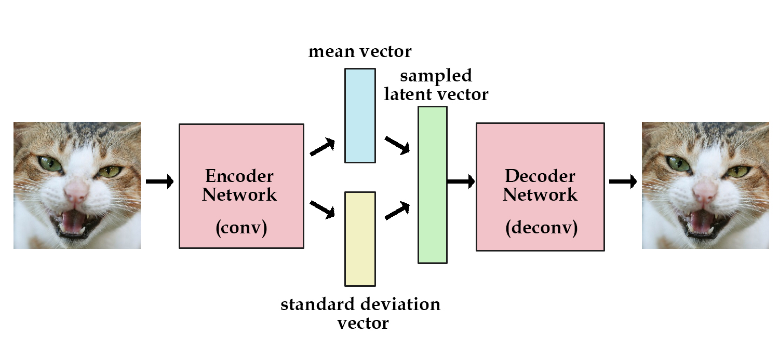
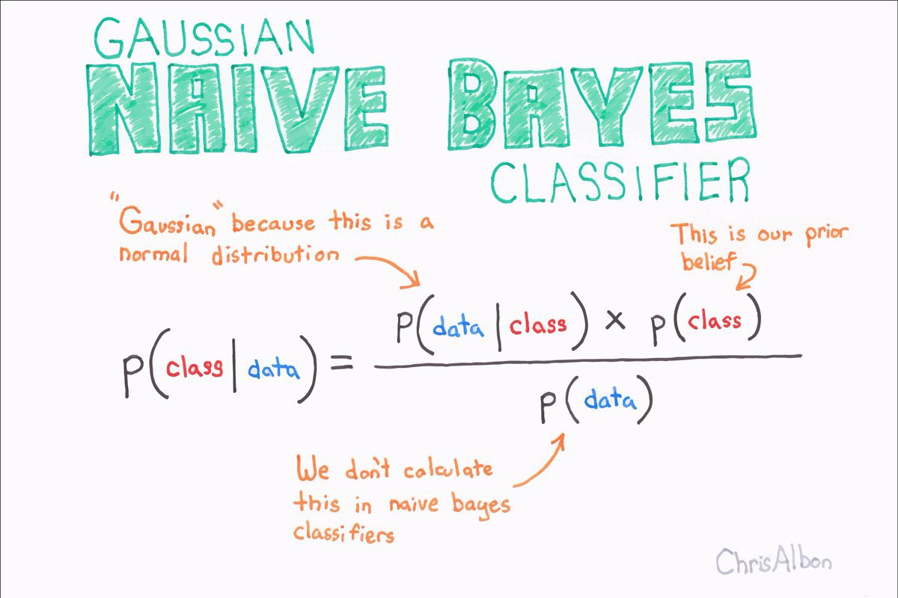
GENERATIVE
Learns the joint probability of x and y
Variational Autoencoder
Naïve Bayes Classifier
Image sources:
https://www.doc.ic.ac.uk/~js4416/163/website/autoencoders/variational.html
https://becominghuman.ai/naive-bayes-theorem-d8854a41ea08

Slide 17
USE AS CLASSIFIER
Infers the conditional probability of y given x
Naïve Bayes Classifier

Slide 18

OR, TO GENERATE NEW SAMPLES
Infers the conditional probability of x given y
Variational Autoencoder
Generative Adversarial Network
Image sources:
https://skymind.ai/wiki/generative-adversarial-network-gan

Slide 19
DISCRIMINATIVE MODELING USING NEURAL NETWORKS

Slide 20

REAL-WORLD DATA IS COMPLEX
A linear model does not has the capacity to fit on non-linear data
Non-linearity needs to be incorporated into the model to improve the accuracy

Slide 21
WAYS TO ADD NON-LINEARITY
Kernel-trick as used in SVM (too generic)
Manually design features (human-effort)
Automatically learn a mapping (representation learning)
Hybrid approach

Slide 22
Feature Engineering is not always possible

Slide 23
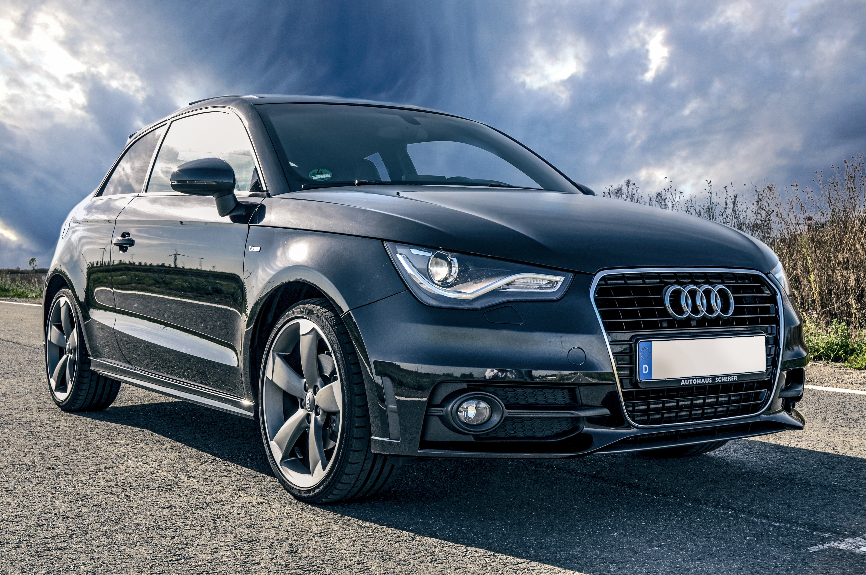
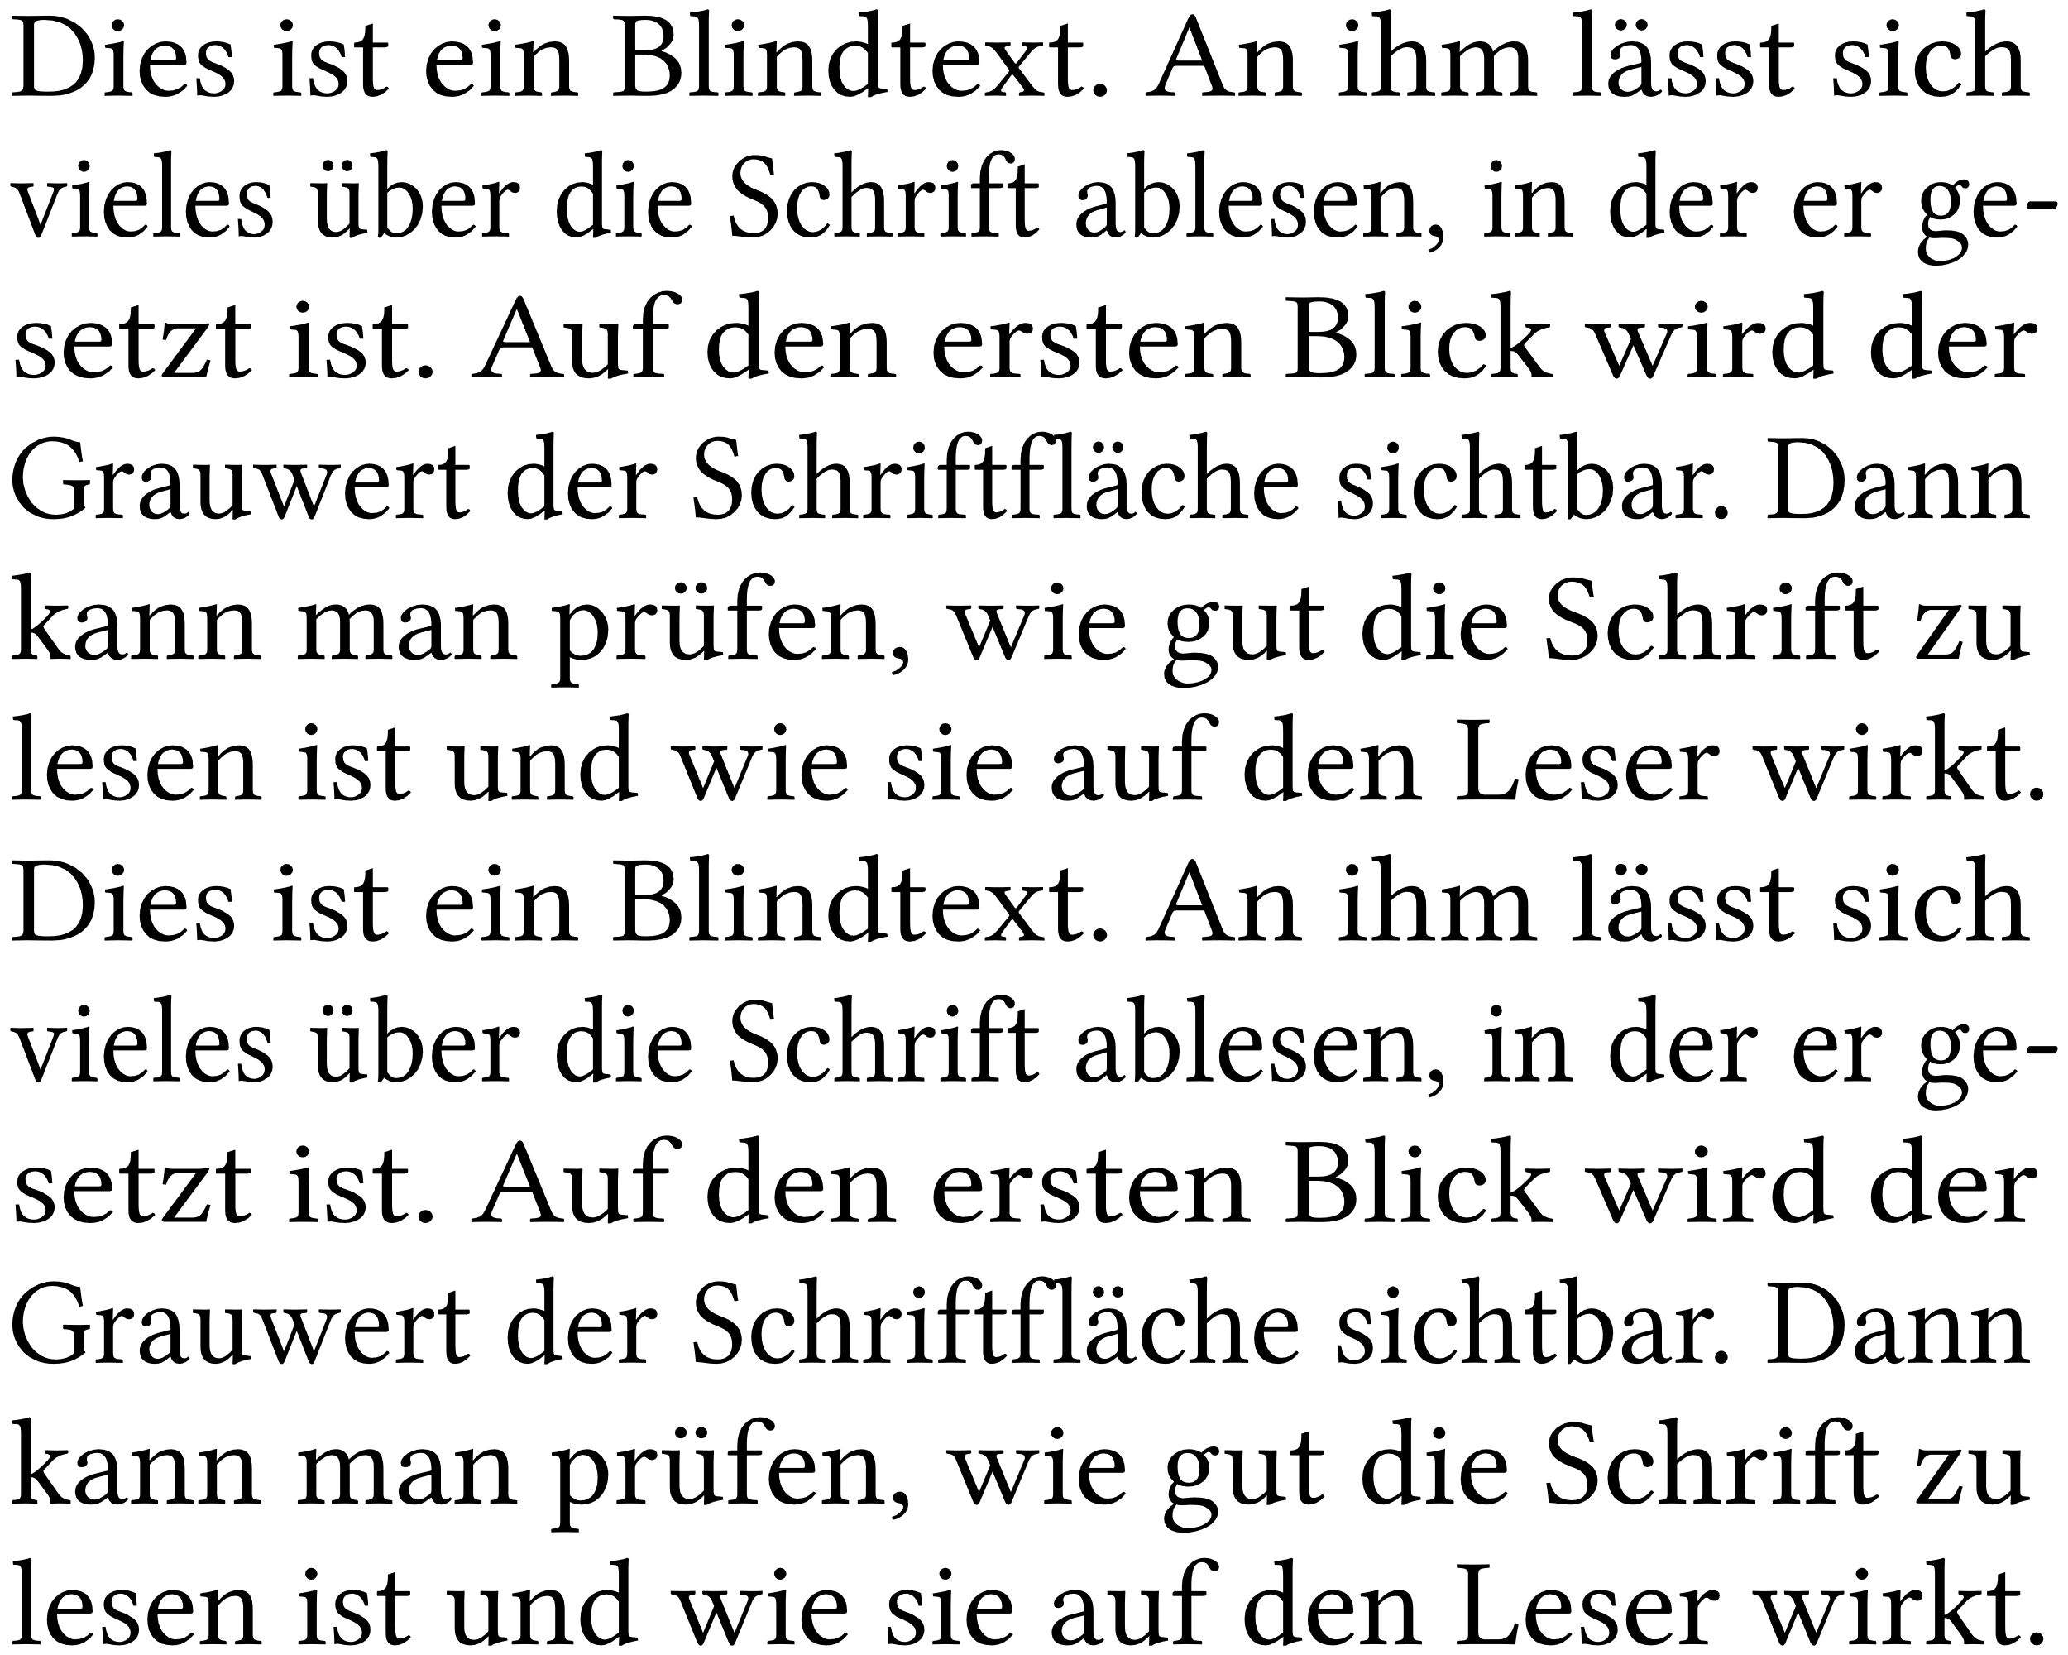
NATURAL DATA IS HIGH DIMENSIONAL
100 x 100 pixels = 10,000 dimensional data
Number of words x Vocabulary size

Slide 24
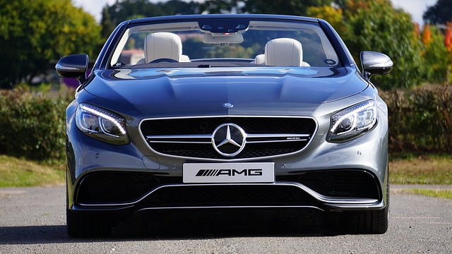
NATURAL FEATURES ARE DIFFICULT TO DESCRIBE
How to describe parts of a car in terms of pixel values?

Slide 25
SOLUTION: REPRESENTATION LEARNING
Automatically learn a representation of the data which is linearly classifiable

Slide 26

NEURAL NETWORKS
Image source: VIASAT

Slide 27
NEURAL NETWORKS
Each layer maps the input vector to a new representation

Slide 28
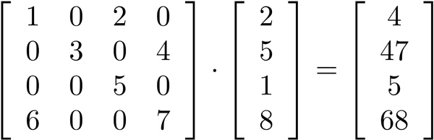
A MATRIX MULTIPLICATION REPRESENTS A LINEAR TRANSFORMATION
The input vector is linearly transformed into a space described by the columns of the matrix
Image source: http://www.c-jump.com/bcc/common/Talk3/Math/Matrices/W01_0060_matrix_by_vector_mult.htm

Slide 29
NEURAL NETWORKS
The input vector is transformed twice before performing classification
2
1

Slide 30
NEURAL NETWORKS
Feature engineering replaced with representation learning
Logistic Regression

Slide 31
NEURAL NETWORKS
The new representation is still a linear transformation of the input

Slide 32

ACTIVATION FUNCTIONS
Apply an activation function at each neuron in the hidden layers
Image source: https://medium.com/@shrutijadon10104776/survey-on-activation-functions-for-deep-learning-9689331ba092

Slide 33
NEURAL NETWORKS
A composite, non-linearly transformed, and linearly classifiable (hopefully) representation of the input vector

Slide 34
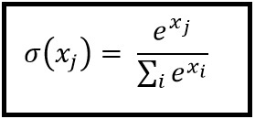
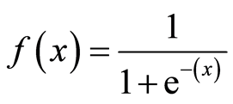
GETTING A VALID PROBABILITY DISTRIBUTION OVER THE CLASSES
Softmax (multi-class classification)
Sigmoid (binary classification)
Image sources:
https://medium.com/@shrutijadon10104776/survey-on-activation-functions-for-deep-learning-9689331ba092
https://www.analyticsindiamag.com/most-common-activation-functions-in-neural-networks-and-rationale-behind-it/

Slide 35
NEXT STEPS
Calculate the loss using cross-entropy between the model’s current probability distribution and the actual probability distribution
Update the model such that it reduces the loss (training)
Repeat until the distributions converge (loss ≈ 0)

Slide 36
TRAINING A NEURAL NETWORK

Slide 37
FINDING OUT THE CONTRIBUTION OF EACH NEURON
Every neuron in a neural network has adjustable weights which can be tuned to minimize the final loss
Every neuron’s contribution to the loss will be different
The adjustment in the weights depends on the contribution of that neuron
How to find out the contribution? (gradients)

Slide 38
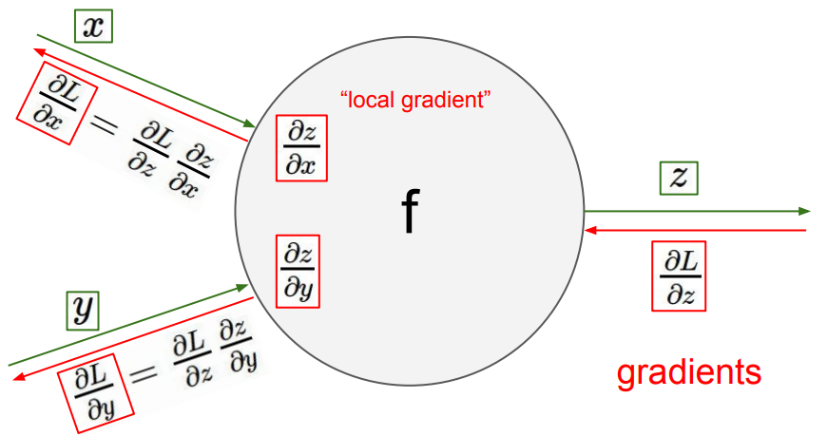
BACKPROPAGATION (CHAIN RULE)
Image source: Stanford CS231n Lecture 4

Slide 39
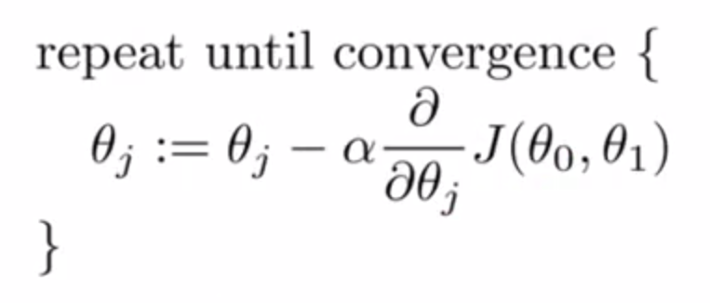
GRADIENT DESCENT

Slide 40
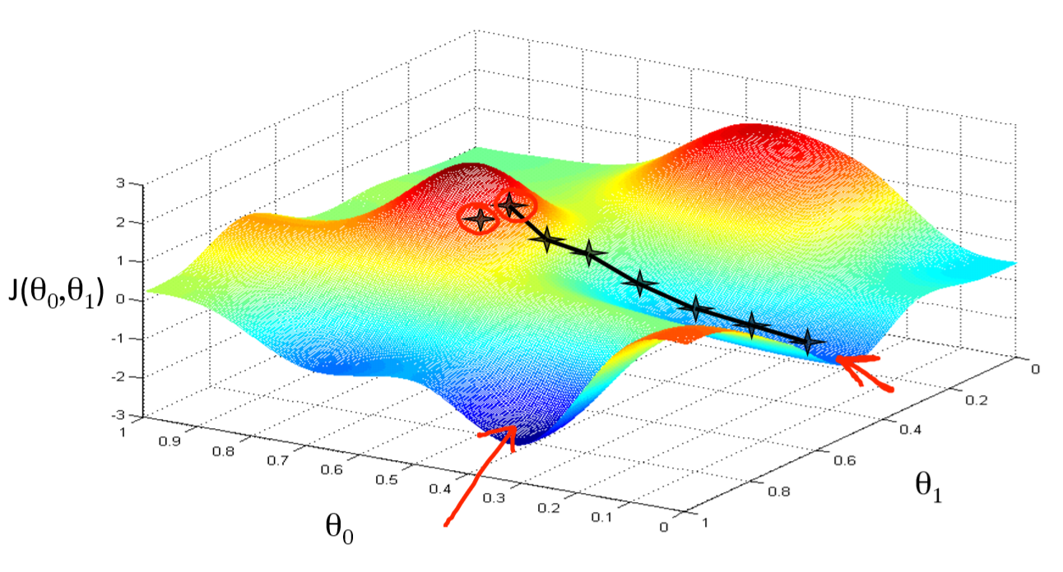
INTUITION BEHIND GRADIENT DESCENT
Number of dimensions = Number of learnable parameters in our neural network
Image source: Andrew Ng’s Coursera course on ML
Notes:
NN: Non-convex landscape due to non-linearity
LR: Convex
Problems of getting stuck in local minima, plateaus
Harder to train than LR
Different optimizers exist

Slide 41
CAN WE DO BETTER?
Specialized Neural Network Architectures

Slide 42

A CAT

Slide 43
THE SAME CAT

Slide 44

SAME…

Slide 45
WE GET IT! STOP IT NOW

Slide 46
DIFFERING WORDS AND LENGTHS BUT SAME MEANING
Would you like to have a pizza?
Here, have pizza.
We are having a pizza party. Would you like to join?
Do you want a pizza?
Pizza?

Slide 47
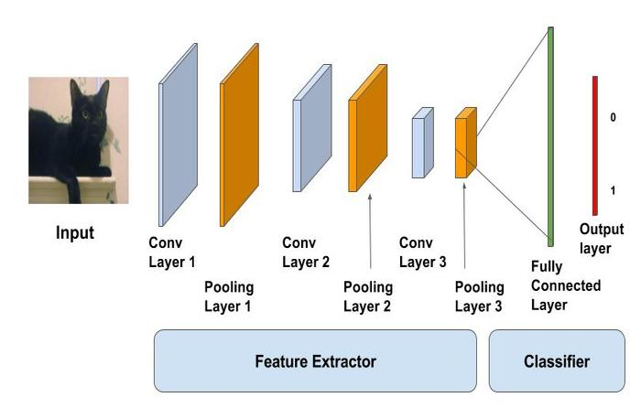
LEARNING BETTER IMAGE REPRESENTATIONS
Still has:
Multiple layers
Non-linearity
Linearly separable in the end
Learns a representation of the image invariant to the location of the object
Convolutional Neural Network
Image source: https://www.learnopencv.com/image-classification-using-convolutional-neural-networks-in-keras/

Slide 48

LEARNING BETTER TEXT REPRESENTATIONS
Still has:
Multiple layers
Non-linearity
Linearly separable in the end
Learns a representation invariant to the length of the text and encodes the MEANING of the text in a fixed-size latent vector
Recurrent Neural Network
Image source: http://colah.github.io/posts/2015-08-Understanding-LSTMs/

Slide 49
SUMMARY
Use a logistic regression classifier in the end.
Find better (linearly separable) representations of the data.
If data is low-dimensional and you have knowledge about the problem’s domain, perform manual feature engineering.
Otherwise, use a relevant neural network architecture.
Cons:
Needs more data
Takes more resources (time and infrastructure) to train
Relatively difficult to code

